Slide 1
deMorgans Laws, logical expressions and Truth Tables
AP Computer Science

Slide 2
Boolean Addition and Multiplication
The OR operation is often called Boolean addition. Variables that are ORed together form a sum term.
The AND operation is often called Boolean multiplication. Variables that are ANDed together form a product term.
Example #1
The expression (A+B+C)(D+E) is the product of two sum terms.
Example #2
The expression AB + CD + AD is the sum of three product terms.

Slide 3
Commutative Laws
The commutative law of addition states that
The order in which variables are ORed makes no difference.
A + B = B + A
The commutative law of multiplication states that
The order in which variables are ANDed makes no difference.
AB = BA
Notes:
Show what this means in terms of gates.

Slide 4
Associative Laws
The associative law of addition states that
When ORing more than two variables, the result is the same regardless of the grouping of the variables.
A + (B +C) = (A + B) + C
The associative law of multiplication states that
When ANDing more than two variables, the result is the same regardless of the grouping of the variables.
A(BC) = (AB)C
Notes:
Show what this means in terms of gates.

Slide 5
Distributive Law
The distributive law is the factoring law. A common variable can be factored from an expression just as in ordinary algebra. That is
AB + AC = A(B+ C)

Slide 6
Rules of Boolean Algebra
1. A . 0 = 0
7. A . A = 0
2. A . 1 = A
8. A + A = 1
=
3. A + 0 = A
9. A = A
4. A + 1 = 1
10. A + AB = A + B
5. A . A = A
6. A + A = A
Notes:
-Discuss Rules 1 to 9 in terms of truth tables of basic gates.
-Rules 10 can be derived from the others; it’s a shortcut rule that may be useful.

Slide 7
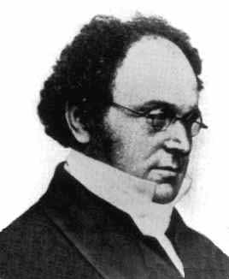
Augustus DeMorgan
My name is Augustus DeMorgan. I’m an Englishman born in India in 1806. I was instrumental in the advancement of mathematics and am best known for the logic theorems that bear my name.
P.S. George Boolean gets WAY too much credit. He has more theorems, but mine are WAY Cooler! Take a look at them, OMG, they are the bomb.
Notes:
A little history…
http://www.math.utep.edu/Faculty/mleung/probabilityandstatistics/chronology.htm

Slide 8
DeMorgan’s Theorems
DeMorgan’s 1st Theorem
The complement of a product of variables is equal to the sum of the complemented variables.
AB = A + B
Notes:
-Here it’s written for 2 terms, but it applies to any number of terms: e.g., (ABC)’ = A’ + B’ + C’

Slide 9
DeMorgan’s Theorems
DeMorgan’s 2nd Theorem
The complement of a sum of variables is equal to the product of the complemented variables.
A + B = A . B
Notes:
-Here it’s written for 2 terms, but it applies to any number of terms: e.g., (A+B+C)’ = A’B’C’

Slide 10
DeMorgan’s Theorem
Example
Apply DeMorgan’s theorem to remove the overbar covering both terms from the
expression X = C + D.
Solution
Notes:
-Another example: ((A+B)C)’ = A’B’ + C’
-Another example: (AB’ + C’D)’ = (A’+B)(C+D’)

Slide 11
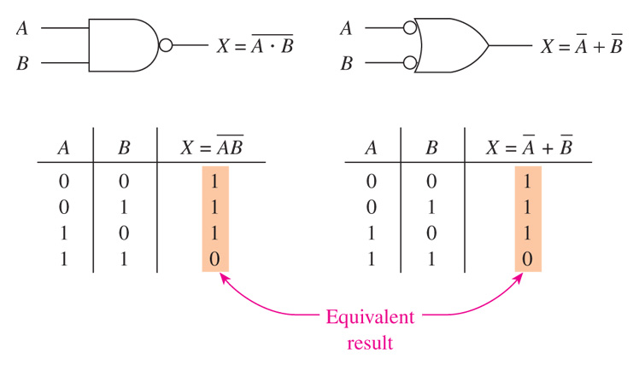
NAND equals “Negative OR”

Slide 12
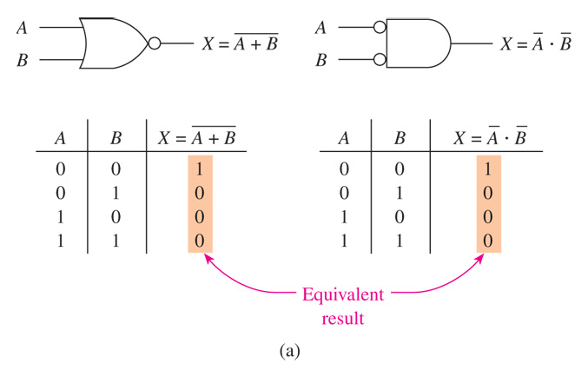
NOR equals “Negative AND”

Slide 13
Simplifying NAND Circuits
Recall that, according to Demorgan’s theorem, the following two representations of a NAND gate are equivalent:

Slide 14
Sum-of-Products form
A Boolean expression is in sum-of-products form (SOP) when it’s written as the sum of one or more products. In SOP form, an overbar cannot extend over more than one variable.
Examples of expressions in SOP form:
A B C + A B A B C + C D AB +AC + D
Product-of-sums form (POS), in which two or more sum terms are multiplied, as in the following examples:
SOP form is more useful than POS form.
(A + B)(A + C) (A + B + C)(B + D) (A + B)(B+C)D
Notes:
-The K-map technique requires you first to put your expression in SOP form.

Slide 15
Truth Table & Logic Expressions
This presentation will demonstrate how to…
Properly construct a truth table.
Write a Sum-Of-Products (SOP) logic expression from a truth table.
Create a truth table given a SOP logic expression.
Create a truth table from a set of design specifications (i.e., word problem).
X | Y | OUT
0 | 0 | 0
0 | 1 | 0
1 | 0 | 1
1 | 1 | 0
EQUALS
EQUALS
Design
Specifications
Truth Table
Logic
Expression
Notes:
Introductory Slide / Overview of Presentation

Slide 16
Constructing A Truth Table
A truth table shows how a logic design’s output respond to ALL combinations of possible inputs.
A logic design with N inputs will have 2^{N} input combinations.
The input are listed in binary order (i.e., counting order) in the columns to the left.
The output(s) are listed in the column(s) to the right. (Note some logic circuits can have more than one output.)

Slide 17
Constructing A Truth Table
Inputs
Output
X | Y | Z | F₁
0 | 0 | 0 | 0
0 | 0 | 1 | 1
0 | 1 | 0 | 0
0 | 1 | 1 | 1
1 | 0 | 0 | 1
1 | 0 | 1 | 0
1 | 1 | 0 | 1
1 | 1 | 1 | 0
Input Combinations
3 – Inputs
8 – Combinations
(8 = 2³)
Note the binary counting
order of the inputs :
Outputs for Each Input Combination
000₂ = 0₁₀
001₂ = 1₁₀
010₂ = 2₁₀
011₂ = 3₁₀
100₂ = 4₁₀
101₂ = 5₁₀
110₂ = 6₁₀
111₂ = 7₁₀
Notes:
Example of a three input / one output truth table

Slide 18
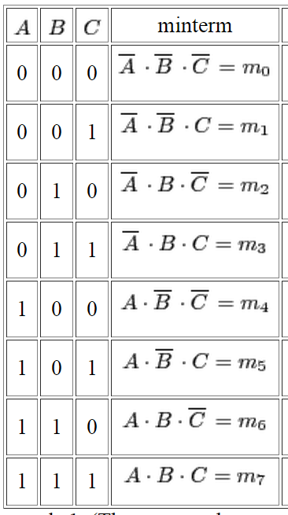
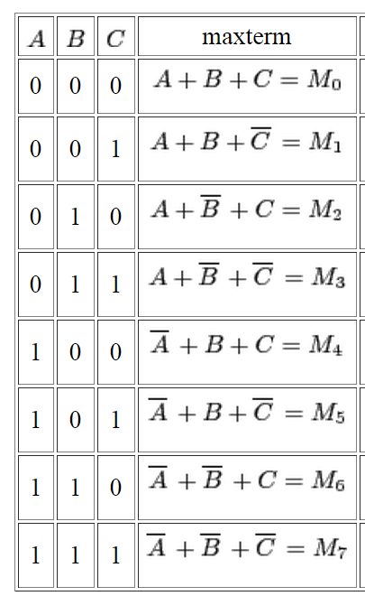
MinTerms and Maxterms

Slide 19
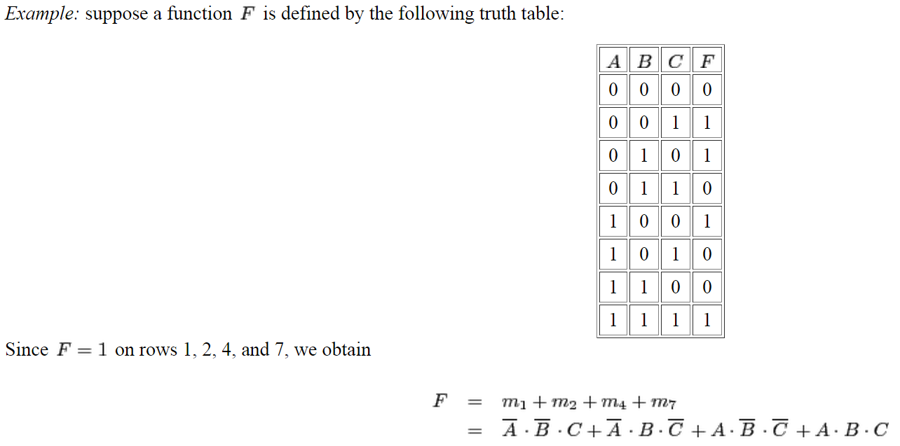
Minterms Examples

Slide 20
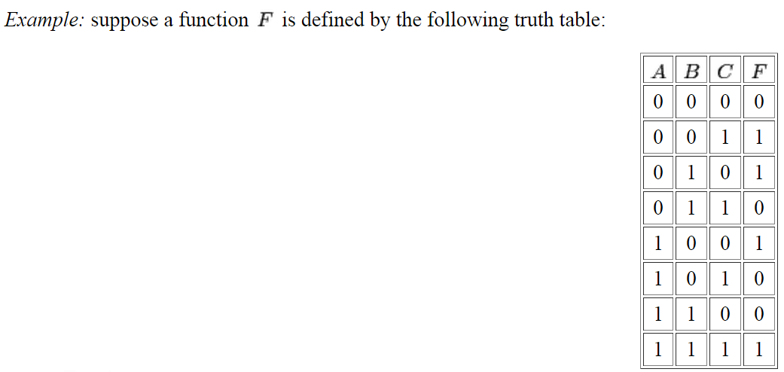
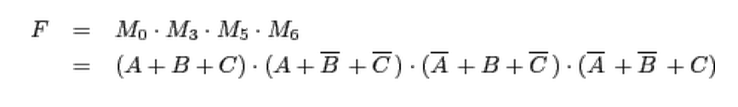

Slide 21
Create Two Logical Expressions for the truth tables
2 Inputs
2² = 4 Combinations
3 Inputs
2³ = 8 Combinations
4 Inputs
2⁴ = 16 Combinations
A | B | F₂
0 | 0 | 0
0 | 1 | 0
1 | 0 | 0
1 | 1 | 1
X | Y | Z | F₃
0 | 0 | 0 | 0
0 | 0 | 1 | 1
0 | 1 | 0 | 0
0 | 1 | 1 | 1
1 | 0 | 0 | 0
1 | 0 | 1 | 1
1 | 1 | 0 | 0
1 | 1 | 1 | 0
R | S | T | U | F₄
0 | 0 | 0 | 0 | 0
0 | 0 | 0 | 1 | 1
0 | 0 | 1 | 0 | 0
0 | 0 | 1 | 1 | 1
0 | 1 | 0 | 0 | 1
0 | 1 | 0 | 1 | 0
0 | 1 | 1 | 0 | 0
0 | 1 | 1 | 1 | 0
1 | 0 | 0 | 0 | 1
1 | 0 | 0 | 1 | 0
1 | 0 | 1 | 0 | 0
1 | 0 | 1 | 1 | 1
1 | 1 | 0 | 0 | 1
1 | 1 | 0 | 1 | 0
1 | 1 | 1 | 0 | 0
1 | 1 | 1 | 1 | 1
Notes:
Format for a 2, 3, & 4 variable true table

Slide 22
SOP and POS forms
Many Boolean expressions are in neither SOP form nor POS form.
Example 1: A(B + C + BC) + (AB + AB)C
Example 2: AB + C(AD + BD)
But every expression can be converted to SOP form by applying some or all of the following: DeMorgan’s theorems, the distributive law, and the commutative law.
Notes:
-Convert the slide’s two examples to SOP form: A’B’C + A’BC + ABC + AB’C and AB + A’CD + BCD’.
-Set up these 2 examples to both sides of the screen.

Slide 23
REVIEW: Writing the SOP Expression for any Truth Table
Given the truth table for a expression, it’s easy to write an SOP-form expression for that expression.
Step 1. For each of the truth table’s rows with a 1 in the output column, list the corresponding product term of the input variables.
Step 2. Add all of the product terms from Step 1.
See example on next slide…

Slide 24
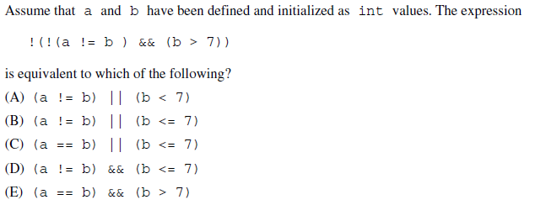
Sample AP Computer Science Question I

Slide 25
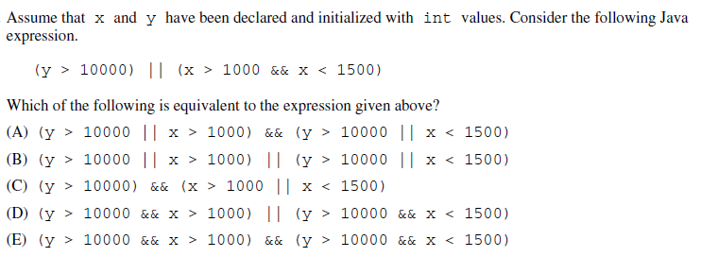
Sample ap computer science Question II

Slide 26
Summary
Boolean & DeMorgan’s Theorems
Commutative Law
Associative Law
Distributive Law
Consensus Theorem
DeMorgan’s
Notes:
Updates of the Boolean Theorems with the addition of DeMorgan’s

